Slide 1


St. MARTIN’S ENGINEERING COLLEGE
UGC Autonomous
NBA & NAAC A+ ACCREDITED
Dhulapally, Secunderabad– 500100
Department of Artificial Intelligence and Machine Learning
Language Identification for Multilingual Machine Translation
Batch No: 16
1. T. Dileep Kumar (21K81A7356)
2. S. Hitesh Kumar (21K81A7353)
3. P. Ganga Prasad (21K81A7345)
Under the Guidance of
Mrs. K. Sai Lakshmi
Assistant Professor
Department of Artificial Intelligence and Machine Learning

Slide 2
OUTLINE
Abstract
Introduction
Literature Survey
Existing System
Proposed System
System Modules
Detailed Design
8. Flow Chart
9. Algorithms
10. Results Obtained
11. References
12. Python Modules
13. Code

Slide 3
ABSTRACT
Machine translation is the process of translating a text in one natural language into another natural language using computer system. Translating a document containing a single source language content is easy but when the information in the source document is given in multilingual format then there is a need to identify the languages that are involved in such multilingual document. Language identification is the task in natural language processing that automatically identifies the natural language in which the content in given document are written in. In this, n-gram based and machine learning based language identifiers are trained and used to identify three Indian languages such as Hindi, Marathi and Sanskrit present in a document given for machine translation. It is observed that, support vector machine-based language identifier is more accurate than any other technique and it achieves 89% accuracy that is 18% more than traditional n-gram based approach.

Slide 4
INTRODUCTION
In today's interconnected world, the demand for seamless communication across languages has driven advancements in machine translation (MT).
A critical component of MT systems is accurate language identification, which determines the language of a given text or speech input.
This process is essential for selecting appropriate translation models and ensuring the fidelity of translated output.
Language identification is particularly challenging in multilingual contexts where texts may contain multiple languages or dialects.
The ability to distinguish between languages accurately is not only crucial for enhancing the precision of translation but also for optimizing computational resources and improving user experience.

Slide 5
INTRODUCTION
Every human being may not be expected to know all the languages
Abundance of useful information is available on the web but may be in foreign language
For making it available in native language of user, first the source language of the information must be identified
Language identification(LI), also called as language guessing, is the task in natural language processing (NLP) that automatically identify the natural language in which the content in given document are written in
Before going for any particular natural language application one must identify the language of the content

Slide 6
LITERATURE SURVEY
S. No | Author | Title | Year | Contributions
1 | Bashir Ahmed, Sung-Hyuk Cha and Charles Tappert | Language identification from text using n-gram based cumulative frequency addition | 2004 | New language classifier is faster and accurate using Cumulative Frequency
2 | Bruno Martins and Mário J. Silva | Language identification in web pages | 2005 | Web language identification software uses n-grams for high accuracy.
3 | Cavnar, W. B., & Trenkel, J. M. | N-gram-based text categorization | 1994 | N-gram approach in text categorization
4 | P. Koehn, H. Hoang, A. Birch, C. Callison-Burch, M. Federico, N. Bertoldi | Moses: open source toolkit for statistical machine translation | 2007 | Open-source SMT toolkit includes advanced decoding and efficient data formats
5 | Kosuru Pavan, Niket Tandon and Vasudeva Varma | Addressing challenges in automatic language identification of romanized text | 2010 | Sentiment analysis task in social media

Slide 7
LITERATURE SURVEY
S. No | Author | Title | Year | Contributions
6 | . D. Goldhahn, T. Eckart and U. Quasthoff | Building large monolingual dictionaries at the leipzig corpora collection: From 100 to 200 languages | 2012 | Leipzig project creates monolingual dictionaries and statistics for many languages
7 | Abdelmalek Amine, Zakaria Elberrichi and Michel Simonet | Automatic language identification: an alternative unsupervised approach using a new hybrid algorithm | 2010 | Hybrid K-means and artificial ants show promise for language identification
8 | E. Tromp and M. Pechenizkiy | Graph-based n-gram language identification on short texts | 2011 | LIGA outperforms existing methods for language identification in short texts
9 | C Sreejith, M Indu, Reghu and P. C. Raj | N-gram based algorithm for distinguishing between Hindi and Sanskrit texts | 2013 | Experiments compare bag-of-words and n-grams for language variety identification

Slide 8
EXISTING SYSTEM
In existing system, it is very difficult to identify language from the given text.
so traditionally it is very difficult by observing these issues some previous authors are using Machine learning algorithms like SVM and KNN but it is giving less accuracy and time taking process
Disadvantages:
Less Accuracy
More time taking process

Slide 9
PROPOSED SYSTEM
In this project we have employed NGRAM and Machine learning algorithms to identify language names from given text.
To evaluate performance, we have utilized various machine learning algorithms such as SVM, KNN and Random Forest for comparison.
Each algorithm performance is tested in terms of accuracy, precision, recall, Confusion matrix graph and FSCORE.
Among all algorithms Random Forest is giving high accuracy.
Advantages:
High Accuracy
Takes less time

Slide 10
SYSTEM MODULES
Upload Language Dataset: using this module we will upload dataset and then remove all missing and special symbols from dataset
Pre-process Dataset: using this module we will convert above process dataset into numeric vector by employing 3 NGRAMS technique and then convert entire text data into numeric vector and then split training data into train and test where application using 80% dataset for training and 20% for testing
Train KNN Algorithm: 80% training data will be input to KNN algorithm to train a model and this model will be applied on 20% test data to calculate prediction accuracy
Train SVM Algorithm: 80% training data will be input to SVM algorithm to train a model and this model will be applied on 20% test data to calculate prediction accuracy

Slide 11
SYSTEM MODULES
5) Train Random Forest Algorithm: 80% training data will be input to Random Forest algorithm to train a model and this model will be applied on 20% test data to calculate prediction accuracy
6) Comparison Graph: will plot comparison between all algorithms
7) Language Detection & Translation: here user can enter some text line and then application will predict language name and then translate that language into English using Google Translator.

Slide 12
DETAILED DESIGN
USE CASE DIAGRAM:

Slide 13
DETAILED DESIGN
SEQUENCE DIAGRAM:

Slide 14
DETAILED DESIGN
COLLABORATION DIAGRAM:

Slide 15
DETAILED DESIGN
COMPONENT DIAGRAM:

Slide 16
FLOW CHART
ACTIVITY DIAGRAM:
Start
Upload Language Dataset
Preprocess Dataset
Train KNN Algorithm
Train SVM Algorithm
Train Random Forest Algorithm

Slide 17
FLOW CHART
ACTIVITY DIAGRAM:
Comparison Graph
Language Detection & Translation
End

Slide 18
FLOW CHART
DATA FLOW DIAGRAM:
User
1. Upload Language Dataset 2. Language Dataset Uploaded
3. Preprocess Dataset 4. Dataset Preprocessed
5. Train KNN Algorithm 6. Train KNN Algorithm Successfully
7. Train SVM Algorithm 8. Train SVM Algorithm Successfully
9. Train RF Algorithm 10. Train RF Algorithm Successfully
11. Comparison Graph 12. Comparison Graph Displayed
13. Language Detection & Translation 14. Language Detection & Translation done
System

Slide 19
ALGORITHMS
K-Nearest Neighbors (KNN):-
Preprocessing: The text data is converted into a TF-IDF matrix where each text document is represented as a vector of numerical features.
Splitting Data: We split the data into training and testing sets to evaluate the model's performance on unseen data.
Training KNN: The KNN classifier is trained by looking at the distances between the test data and its nearest neighbors in the training set.
Prediction: For a new text, the model finds the closest k neighbors and assigns the most common class.
Evaluation: The performance of the model is evaluated using metrics like accuracy, precision, etc.

Slide 20
ALGORITHMS
Support Vector Machine (SVM):-
Preprocessing: The text data is transformed into a TF-IDF matrix where each document is represented as a numerical vector.
Splitting Data: As usual, the data is split into training and test sets for validation.
Training SVM: The SVM classifier tries to find the hyperplane that best separates the classes in the data.
Prediction: For the test set, the classifier predicts the class labels based on the learned hyperplane.
Evaluation: The performance is measured using accuracy, but you can also use other metrics like precision, recall, and F1-score for imbalanced datasets.

Slide 21
ALGORITHMS
Random Forest for text:-
Preprocessing: We convert the text into a TF-IDF matrix where each document is represented as a vector of numerical features.
Splitting Data: As usual, the data is split into training and test sets to validate the model on unseen data.
Training Random Forest: The Random Forest classifier builds an ensemble of decision trees on various sub-samples of the dataset and aggregates their predictions to improve accuracy and control overfitting.
Prediction: For the test data, the classifier aggregates the results from all decision trees and returns the most voted class label.
Evaluation: The performance of the classifier is evaluated using accuracy. You can also use metrics like precision, recall, and F1-score depending on the problem.

Slide 22
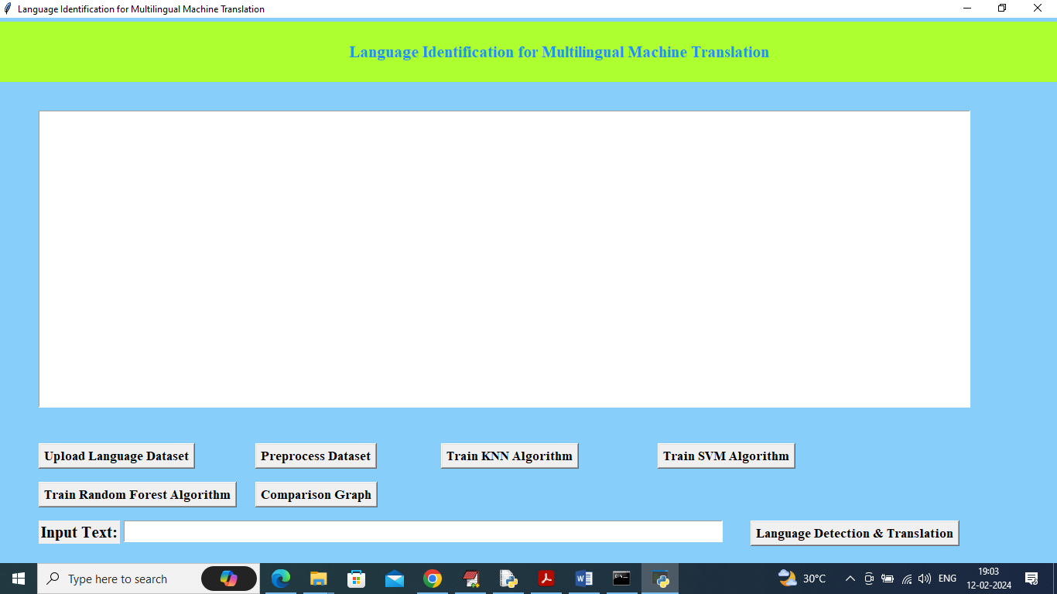
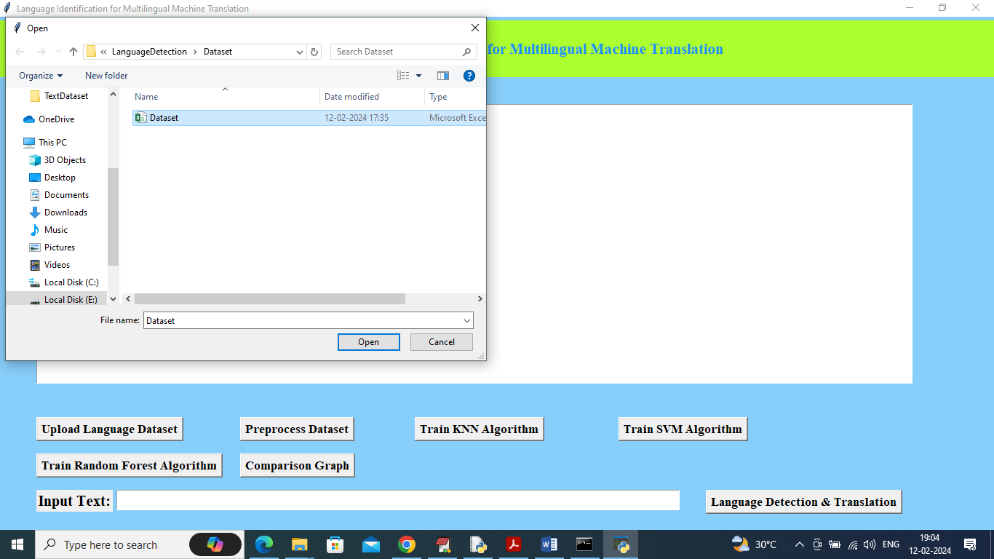
RESULTS OBTAINED
To run project double click on run.bat file to get above screen
In above screen selecting and uploading dataset file and then click on ‘Open’ button to load dataset and get below page

Slide 23
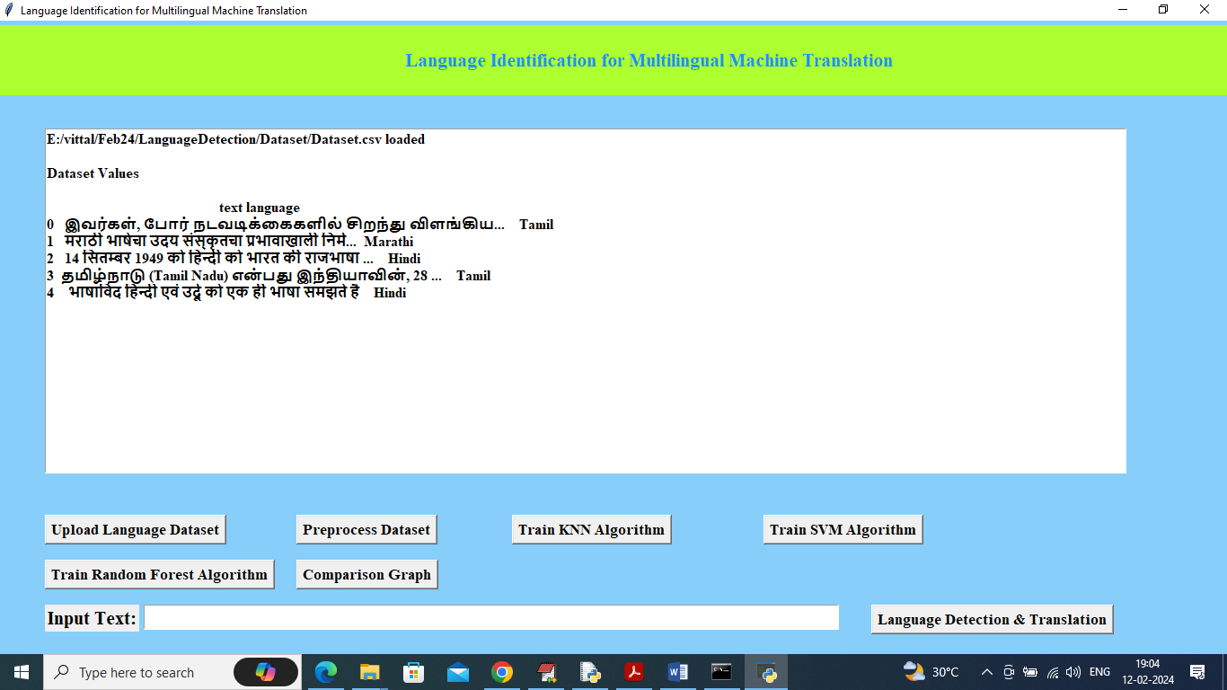
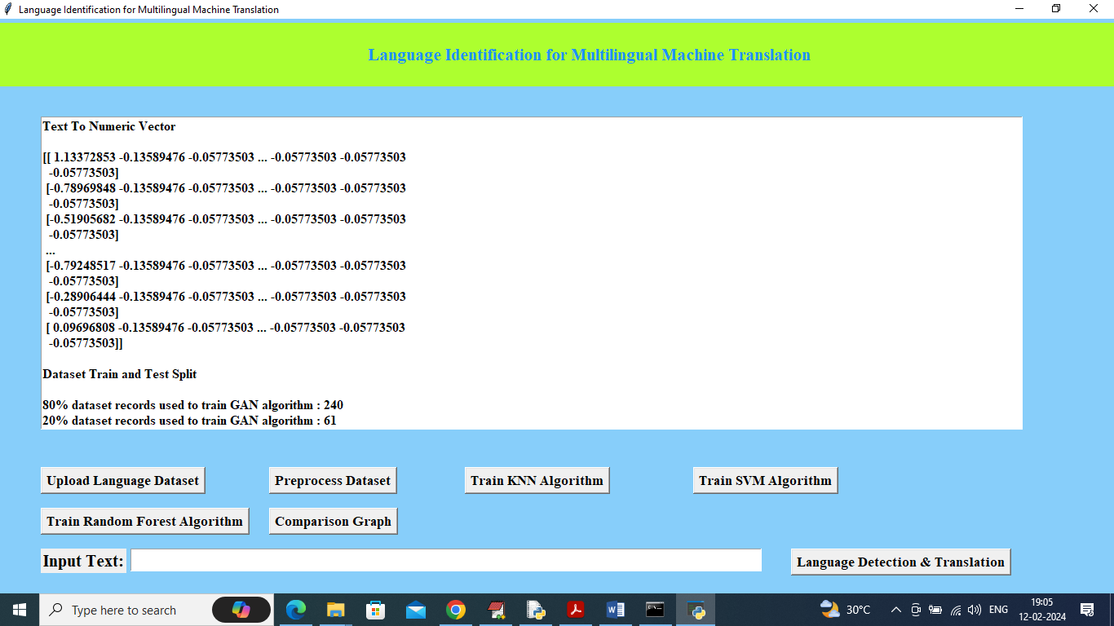
RESULTS OBTAINED
In above screen dataset loaded and now click on ‘Pre-process Dataset’ button to clean dataset and get below output
In above screen entire text data converted to numeric vector by using 3 NGRAM techniques and then can see train and test split details and now click on ‘Run KNN Algorithm’ to train KNN and get below output

Slide 24
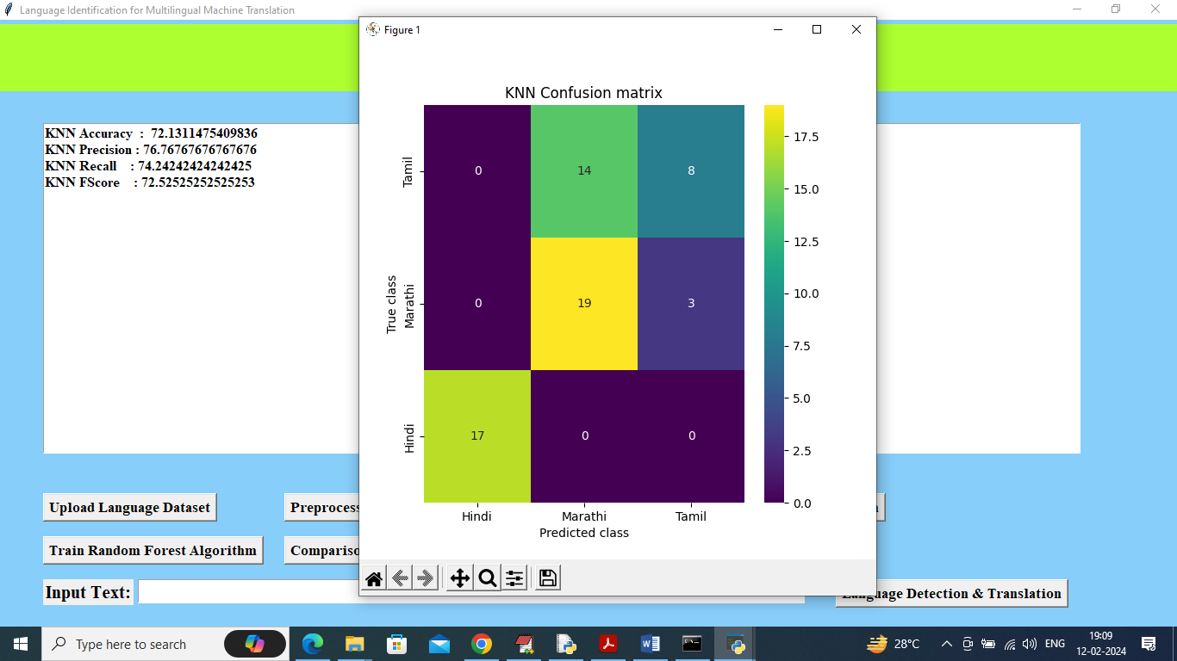
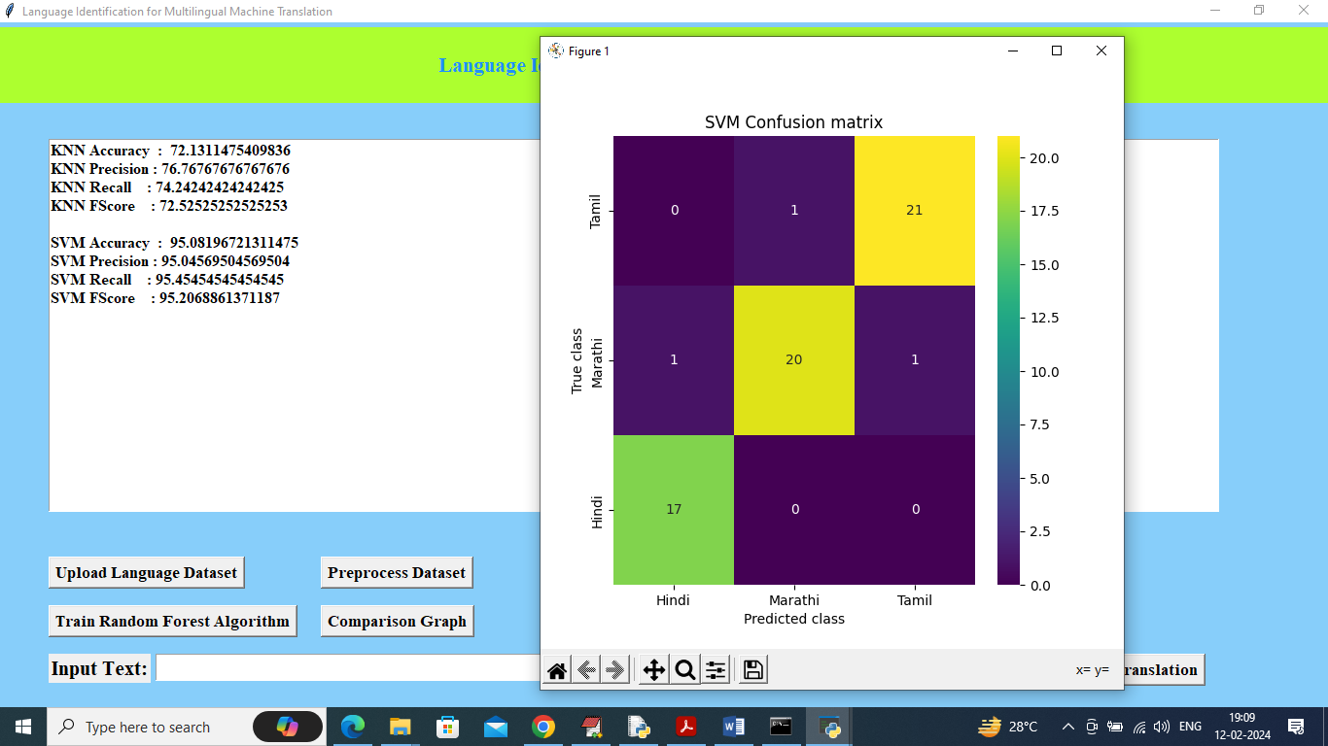
RESULTS OBTAINED
In above screen KNN training completed and it got accuracy as 72% and can see other metrics also and in confusion matrix graph x-axis represents Predicted Labels and y-axis represents True Labels
In above screen SVM got 95% accuracy and can see other metrics also and now click on ‘Train Random Forest’ to get below output

Slide 25
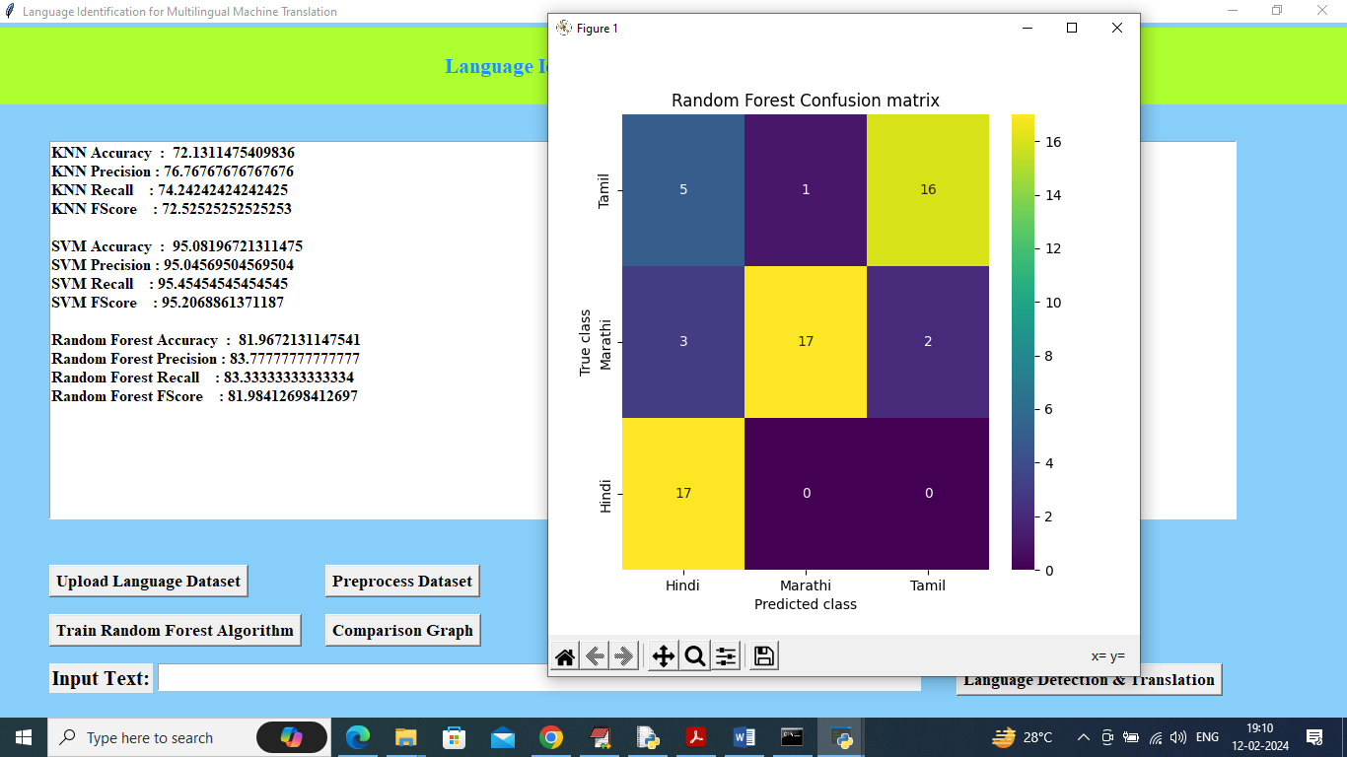
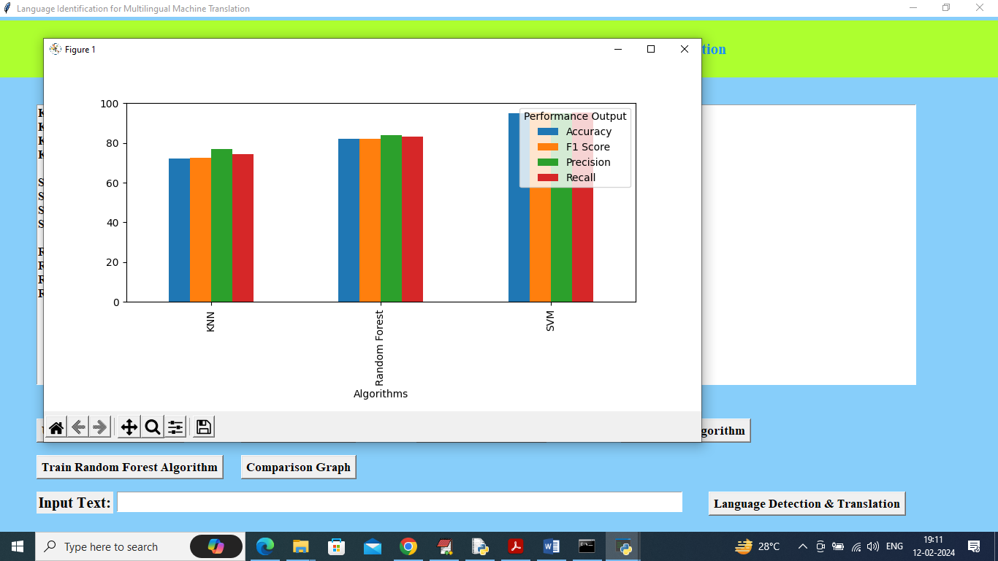
RESULTS OBTAINED
In above screen Random Forest got 81% accuracy and now click on Comparison Graph button to get below output
In above graph x-axis represents algorithm names and y-axis represents accuracy and other metrics in different colour bars

Slide 26
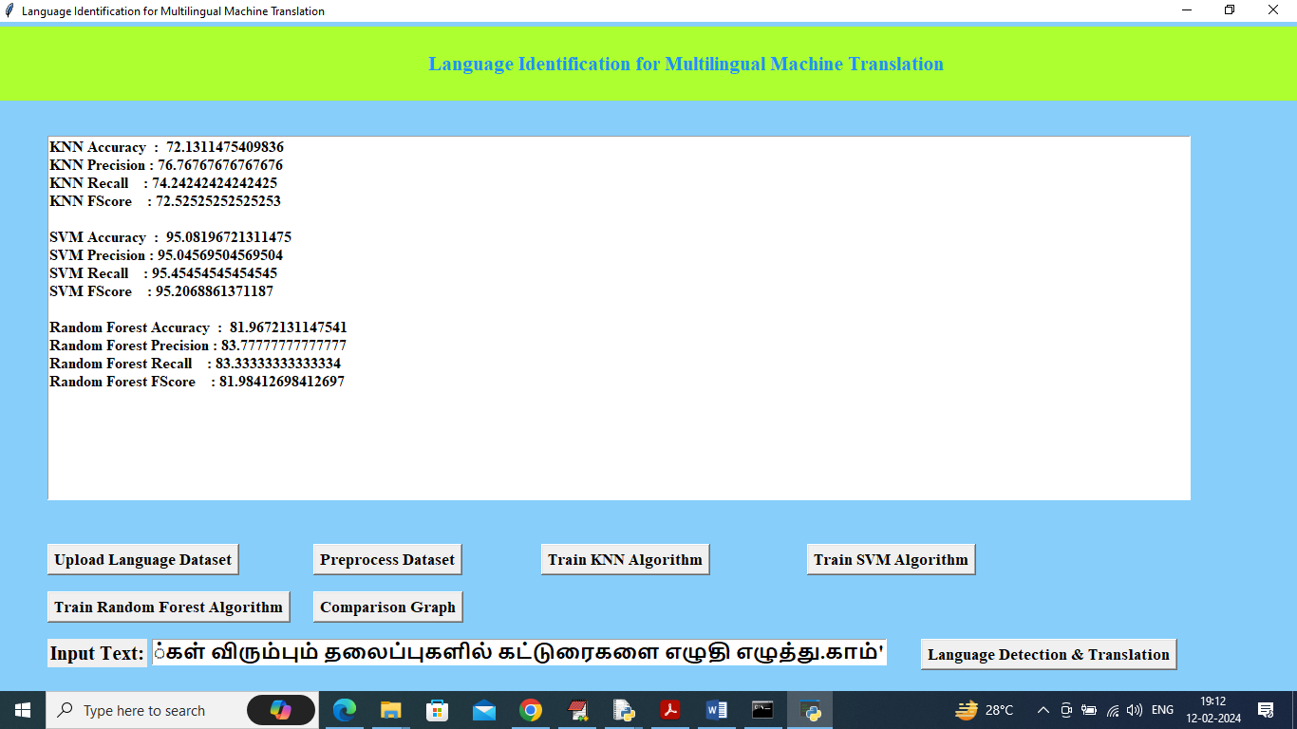
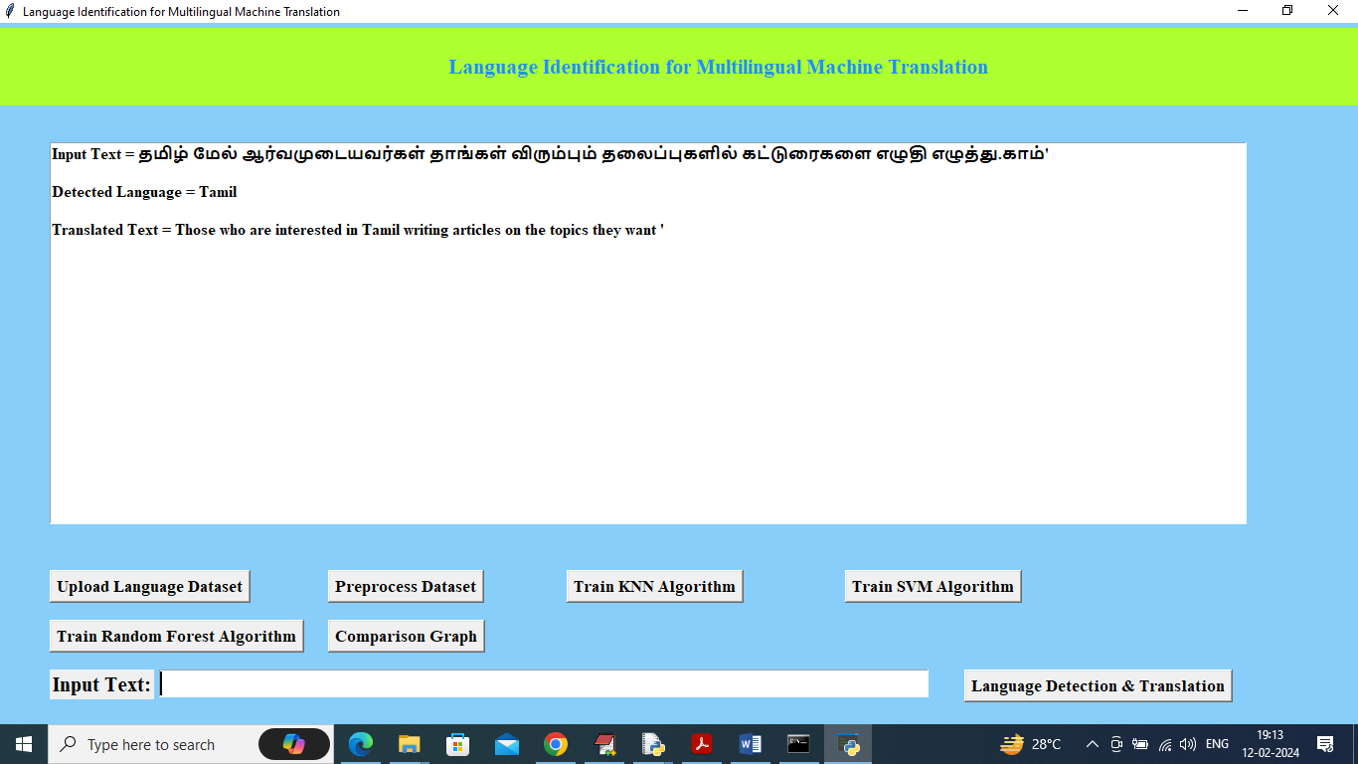
RESULTS OBTAINED
In above screen I entered some text in text field and then press Language Detect button to get below output
In above screen in text area can see Detected Language Is Tamil and can see Translated text in English and below is another example

Slide 27
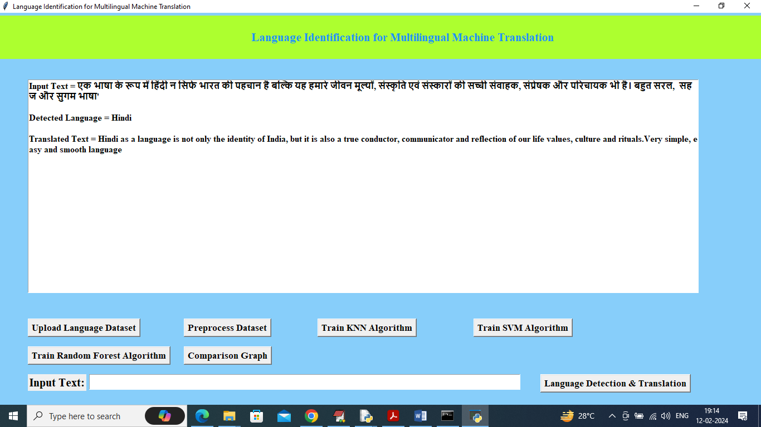
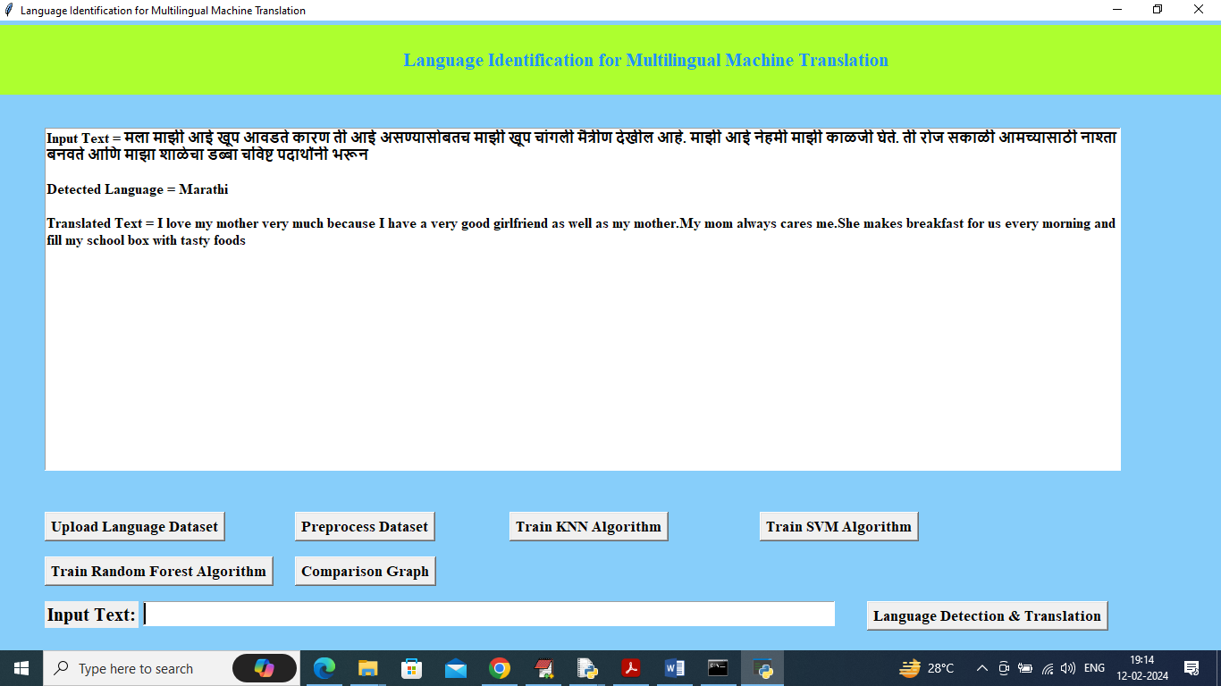
RESULTS OBTAINED
In above screen detected language is Hindi with translation
In above screen detected language is Marathi with English translation.

Slide 28
REFERENCES
[1]. Brown, P. F., Cocke, J., Della Pietra, S. A., Della Pietra, V. J., Jelinek, F., Mercer, R. L., & Roossin, P. S. (1990). A statistical approach to language translation. Computer, Speech & Language, 4(1), 25-47.
[2]. Nakov, P., Zampieri, M., Rosenthal, S., Atanasova, P., Karov, I., Mubarak, H., ... & Martin, B. (2017). SemEval-2017 task 4: Sentiment analysis in Twitter. In Proceedings of the 11th International Workshop on Semantic Evaluation (SemEval-2017) (pp. 502-518).
[3]. Cavnar, W. B., & Trenkle, J. M. (1994). N-gram-based text categorization. In Proceedings of SDIR-94, 3rd Annual Symposium on Document Analysis and Information Retrieval (pp. 161-175).
[4]. Luong, M. T., Pham, H., & Manning, C. D. (2015). Effective approaches to attention-based neural machine translation. In Proceedings of the 2015 Conference on Empirical Methods in Natural Language Processing (pp. 1412-1421).

Slide 29
REFERENCES
[5]. Vaswani, A., Shazeer, N., Parmar, N., Uszkoreit, J., Jones, L., Gomez, A. N., ... & Polosukhin, I. (2017). Attention is all you need. In Advances in Neural Information Processing Systems (pp. 5998-6008).
[6]. Liu, Y., Li, S., Zhang, H., & Liu, D. (2020). A novel language identification method based on enhanced deep neural network. Journal of Information Science, 46(5), 617-630.
[7]. Koehn, P. (2009). Statistical machine translation. Cambridge University Press.
[8]. Bahdanau, D., Cho, K., & Bengio, Y. (2014). Neural machine translation by jointly learning to align and translate. arXiv preprint arXiv:1409.0473.
[9]. Lui, M., & Baldwin, T. (2012). langid.py: An off-the-shelf language identification tool. In Proceedings of the ACL 2012 System Demonstrations (pp. 25-30).

Slide 30
PYTHON MODULUS
Pandas : Pandas are a Python computer language library for data analysis and manipulation.
NumPy : The NumPy Python library for multi-dimensional, big-scale matrices adds a huge number of high-level mathematical functions.
Matplotlib : It is a multi-platform, array-based data visualization framework built to interact with the whole SciPy stack.
Scikit-learn : The most stable and practical machine learning library for Python is scikit-learn.
Keras : Google's Keras is a cutting-edge deep learning API for creating neural networks.
h5py : The h5py Python module offers an interface for the binary HDF5 data format.
Tensor flow : TensorFlow is a Python library for fast numerical computing created and released by Google.

Slide 31
PYTHON MODULUS
Tkinter : Tkinter is an acronym for "Tk interface". Tk was developed as a GUI extension for the Tcl scripting language by John Ousterhout.
NLTK : NLTK is a toolkit build for working with NLP in Python. It provides us various text processing libraries with a lot of test datasets.
Scipy : SciPy is a collection of mathematical algorithms and convenience functions built on the NumPy extension of Python.

Slide 32
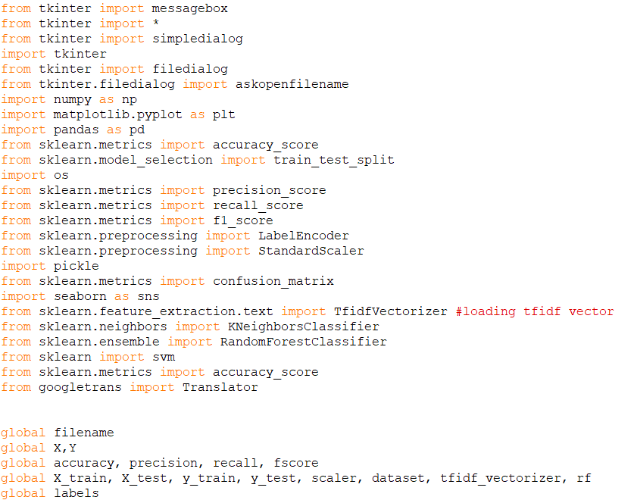
CODE

Slide 33
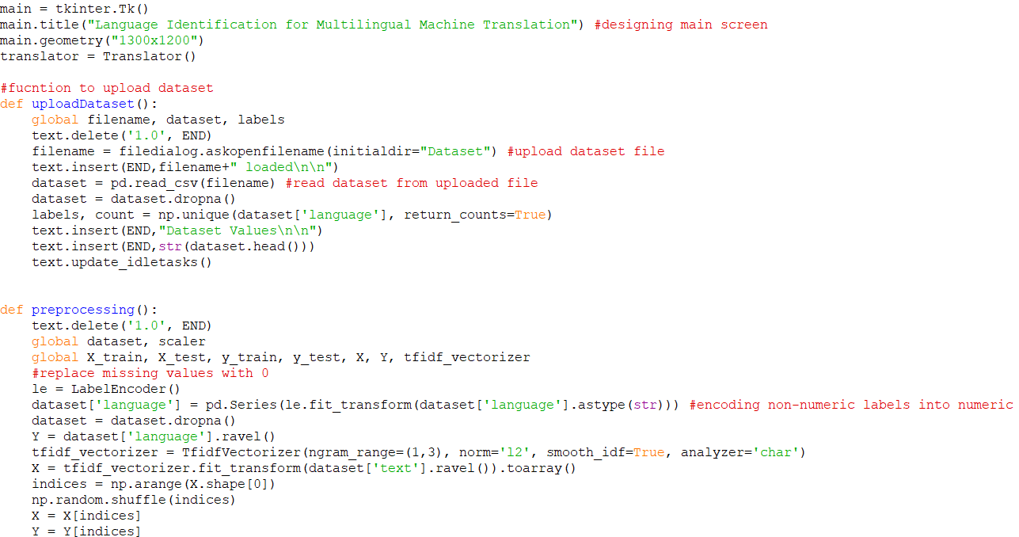
CODE

Slide 34
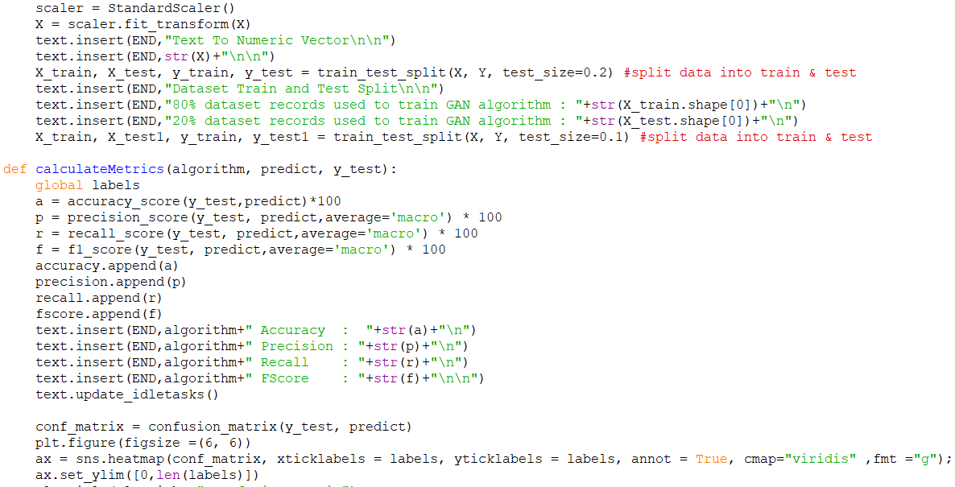
CODE

Slide 35
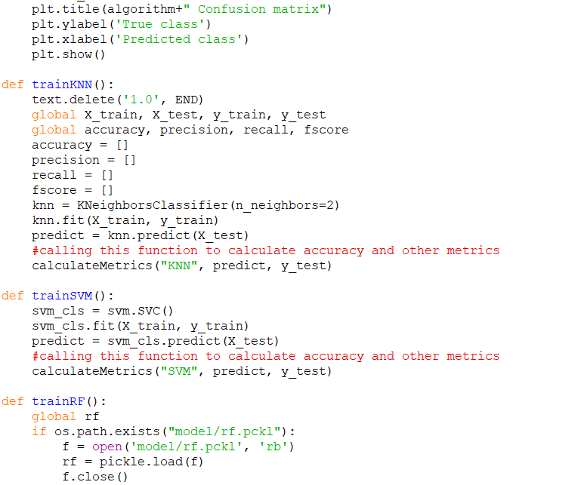
CODE

Slide 36
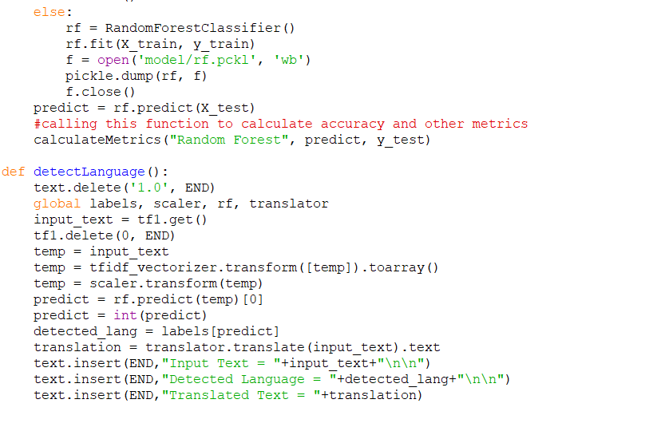
CODE

Slide 37
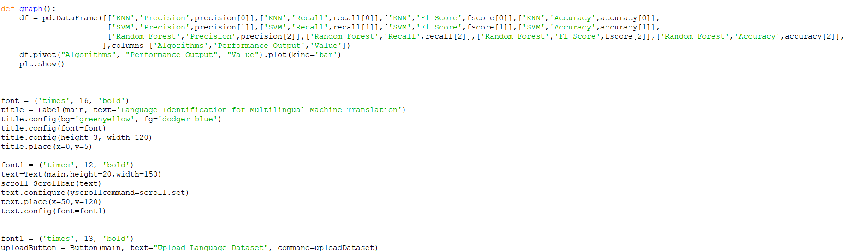
CODE

Slide 38
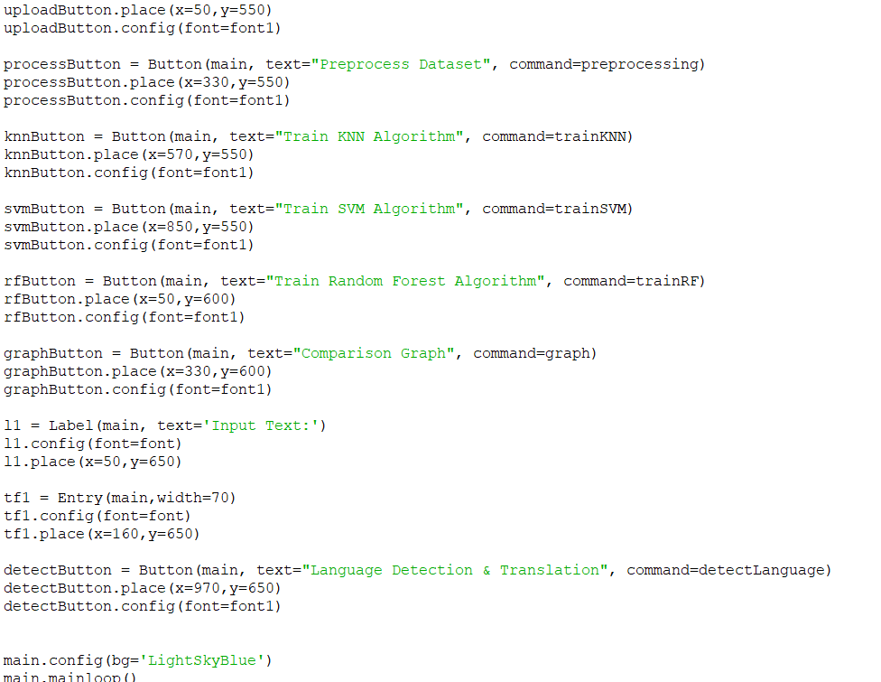
CODE

Slide 39
QUERIES ??

Slide 40
THANK YOU

